Slide 1

A study in (HCI) human computer interaction
By Ramnik Dhoot

Slide 2
12341
Introduction
In this presentation I will discuss:
What HCI is
Why it's important
The Aims and objectives of my project
How I have applied everything I have learnt to create 3 User interface that implements key principles of HCI

Slide 3
12341
What is HCI
Human-Computer Interaction is a field of study that focuses on the design and use of computer technology
The goal of HCI is to improve the interaction between users and computer systems
Key aspects of HCI, such as cognitive psychology, design principles, and evaluation methods
HCI principles help designers design the most usable interfaces for users.

Slide 4
Nielsen's usability heuristics
Visibility of System Status
Match with the Real World
Consistency and Standards
Error Prevention
Recognition Over Recall
Aesthetic and Minimalist Design

Slide 5
123
Importance of HCI
The significance of HCI lies in its direct and profound impact on our daily lives.
HCI principles serve as a guide for UI designers, making the interactions we have with computers as efficient, effective, and enjoyable as possible.
Users seek interfaces that allow them to complete tasks quickly and effortlessly.

Slide 6



The relevance of HCI in today's technology-driven world
Medical devices: Medical devices are safe and easy to use for both patients and healthcare professionals. | Websites and Other technology: HCI can help to ensure that websites and mobile apps are easy to navigate and use for users. | Clear communication: Safety critical systems should have intuitive interactions to prevent potential hazards or errors.

Slide 7
1234
Aims and objectives
In this project I will explore how crucial a systems design is.
Employ the acquired knowledge to design three distinct Proof of concept Ui's
a shopping website
Database Management System (DBMS) Interface
Note taking application
Evaluate the UIs based on usability, efficiency, and user satisfaction.
Complete a comprehensive final report, outlining the entire design process.

Slide 8
1234
My User interfaces
I will then talk about each of my Ui's:
They are all targeted towards different user groups
Then I will explain the HCI principles I have used

Slide 9
The Design Process
What is Wanted
Task Analysis
Guiding HCI principles
Analysis
Precise Specifications
Design
HCI Heuristics
Implement and deliver product
Prototyping
Testing and evaluation

Slide 10

Shopping Website
Targeted towards visually impaired users
The main HCI principle for this is accessibility
Accessibility Commitment: Prioritizing simplicity and ease of use, especially for screen reader users.
Design Elements: Bootstrap, HTML, clear navigation, high contrast, and keyboard accessibility.

Slide 11
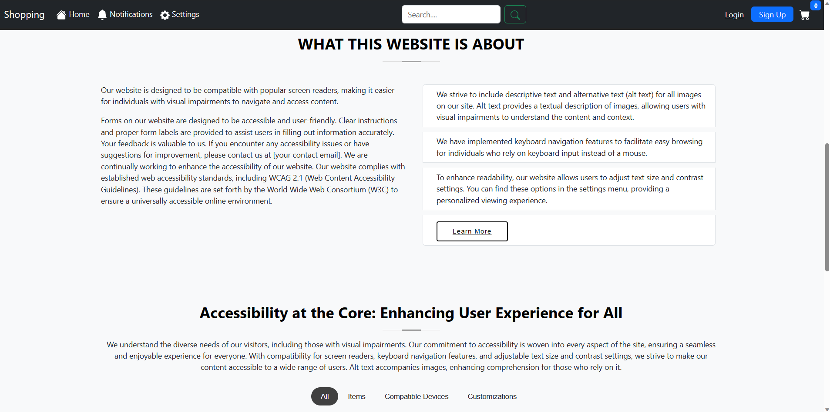
Clarity and usability
Accessibility
Error prevention
Consistency
Learnability
Feedback

Slide 12
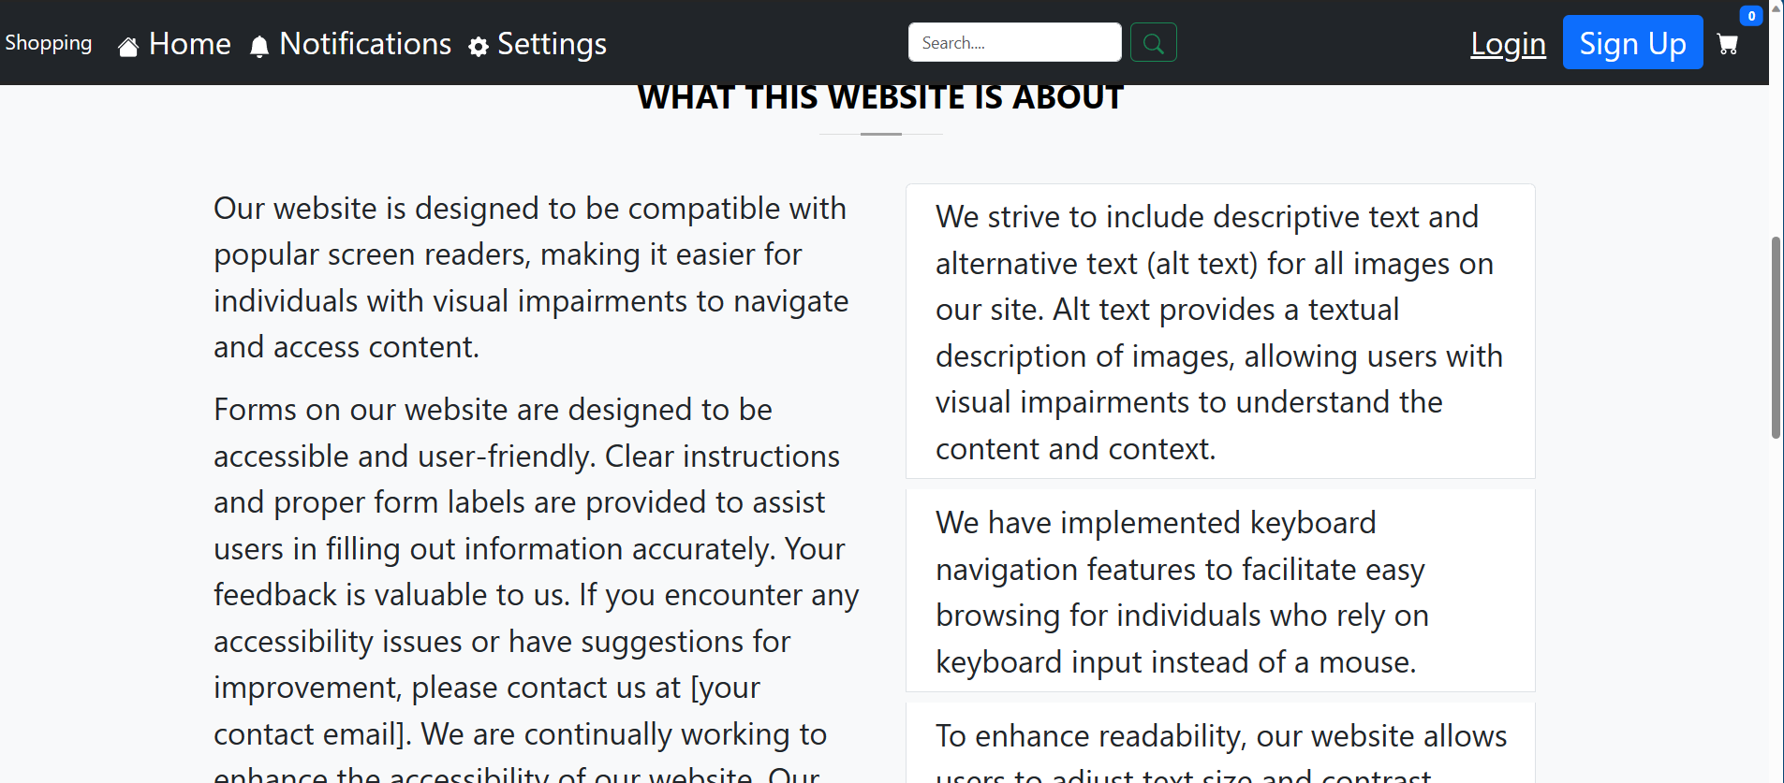
Larger text Mode

Slide 13
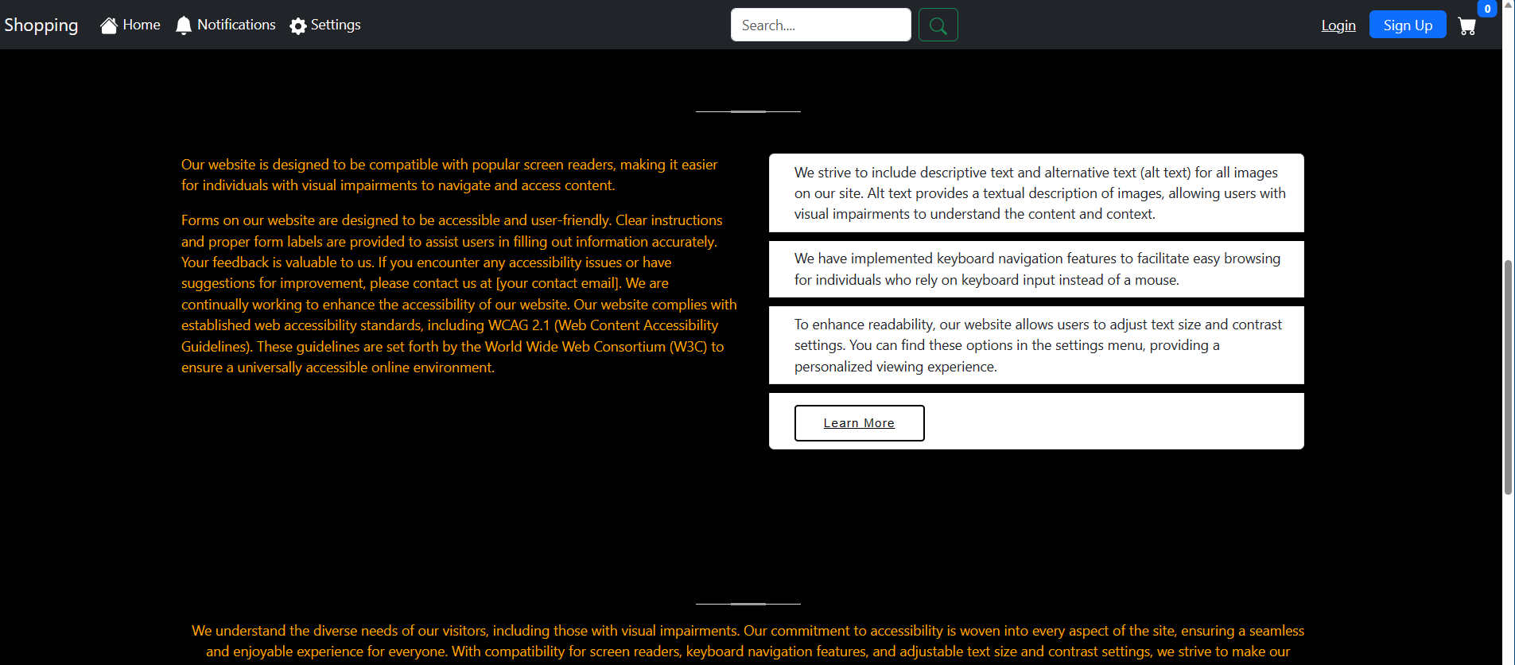
High-Contrast Mode

Slide 14

Database interface
Business owners managing warehouse inventory across various devices.
Portability: Responsive Design utilizing Bootstrap for responsive layouts and enhanced visual appeal.
Security Measures: Account functionality with defined user roles and permissions.
Technology Stack: Back end using Java, Spring Boot, and servlet library for efficient database interaction.

Slide 15
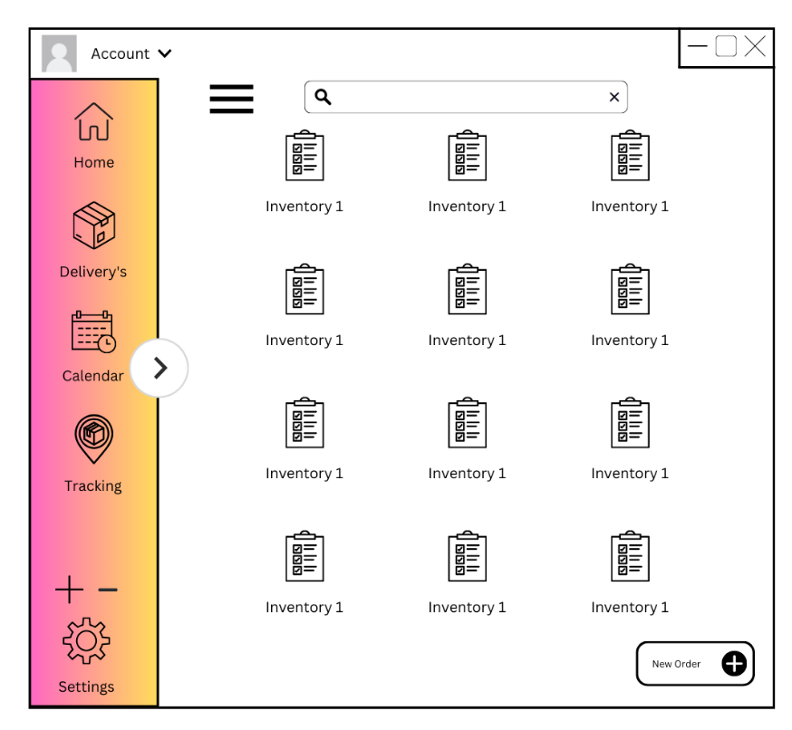
Scalability
Feedback
Efficiency
Customization
Memorability
Robustness
Learnability
Recall

Slide 16

Notes taking application
Technology: Utilizing Swing, a Java library, for the graphical user interface.
Targeted towards Students (ages 14-21)
The main HCI principle for this is User Control and Freedom
Functionality: Simple note-taking application with essential features – save, load, delete, change size, and change font.
User-Friendly Design

Slide 17
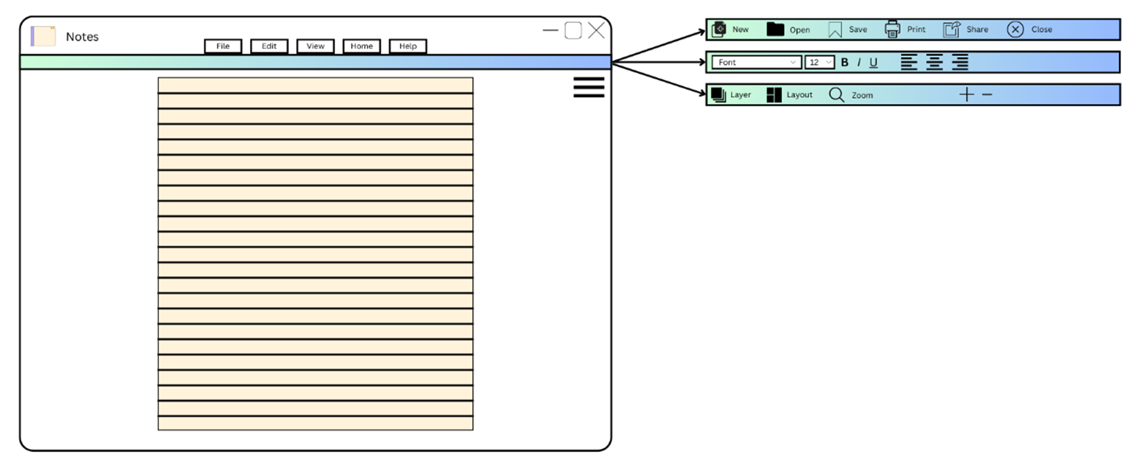






Flexibility
Error Prevention
Usability
Efficiency
Focus
Satisfaction

Slide 18



Conclusion and Future steps
HCI is essential for UI designers, bridging the gap between technology and user expectations. Adhering to HCI principles enhances interfaces, ensuring a positive, seamless user experience and making technology accessible to diverse users.
My future work involves further incorporating additional HCI principles and functionality into my interfaces.
Also, to continue my HCI research and write a conclusive report on the topic.

Slide 19

Any Questions?

